Slide 1

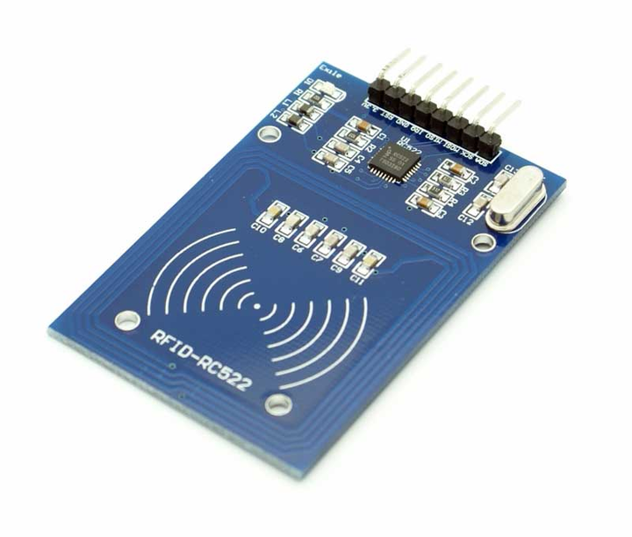
Arduino RFID based
smart lock
Presented By: Sakshi kumari
Indubhusan Sahoo
Ragini Singh
5th December 2023

Slide 2
Table of Index
project objective
hardware components
circuit diagram
step by step assembly
software overview
code explaination
testing and troubleshooting
project demonstration
conclusion
references
question and answer

Slide 3
Goal of the object
The primary goal of this project is to design and implement a
functional RFID-based smart lock system using Arduino,
providing a practical application of RFID technology in the
realm of access control.
Learning outcome
To familiarize users with RFID technology and its
implementation.
To demonstrate the integration of RFID readers with Arduino
for data processing.
To create a secure access control system using RFID cards and
Arduino.
To facilitate learning in basic electronics, programming, and
security system design.
l

Slide 4
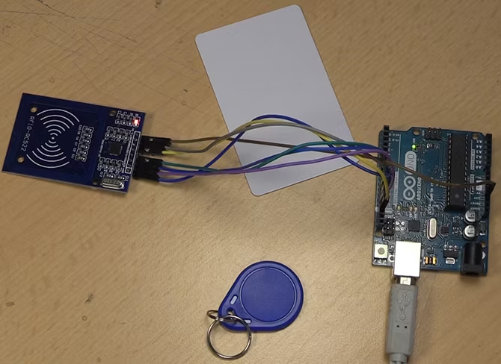
Hardware Components
a. Arduino Board
b. MFRC522 RFID Module
c. LEDs
d. Resistors
e. MOSFET
f. Solenoid Lock
g. Power Supply
h. Breadboard and Wires

Slide 5
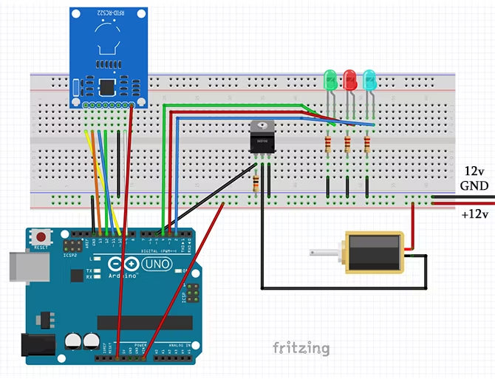
Circuit Diagram

Slide 6
1. Setting Up the MFRC522 Module:1. Setting Up the
step-by-step assembly
1. Setting Up the MFRC522 Modul
2. Adding Components
3. Power Connections
4. Testing the Setup

Slide 7
software overview
a. Arduino IDE
b. RFID Library (e.g., MFRC522 Library)
c. Access Control Sketch
CODE SNIPPET
void accessGranted()
void accessDenied()
bool authenticate(String

Slide 8
Code Explaination
The code initializes the RFID reader, LED pins, and MOSFET pin.
The accessControl() function manages card detection and
calls other functions accordingly.
The authenticateCard() function can be customized for
specific access control logic.
The grantAccess() and denyAccess() functions control LED
feedback and lock activation.
The adminMode() function indicates when the master card is
detected, allowing access to admin features.

Slide 9
Testing and trouble shooting
Take one last quick look over your wiring to check everything is in place, and connect your 12v power supply. At this point, it is worth mentioning that you should be wary of the duty cycle of your solenoid. The cheap solenoid I am using for this test does not have a 100 percent duty cycle, consequently it should not be left in it's locked position for long periods of time. To make this into a permanent setup, use a 100 percent duty cycle solenoid.
When the circuit is powered up, the Blue LED should light up to show that the device is operational. Holding the master card over the reader puts it in admin mode should cause all three LEDs to flash. While they are flashing you can hold other cards or fobs over the reader to add or take away access rights. It

Slide 10
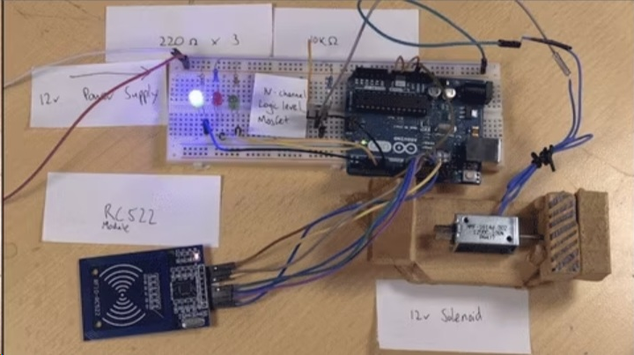
Project demonstration

Slide 11
Conclusion
While this project is a simple start in using RFID devices in our DIY setup, it is not the most secure setup. We don't suggest jury rigging this to your front door.
You could build the whole mechanism into a box, and use the solenoid to lock it. Fill the box with cookies, and use your master key to decide who has access and who doesn't. Become the cookie master!

Slide 12
References
Ian Buckley's DIY Smart Lock Article
MFRC522 Library Documentation

Slide 13

THANK YOU

Slide 14
Question And Answer

